Slide 1

Cisco 3D Hackathon
Who’s the Next IPL Winner?
Team 2: Rishabh Dutt
Vedanti Ladda
Amogh M. K
Sahiti Vallamreddy

Slide 2
Approach
Data Collection, Extraction and Normalization:
Determining the amount and type of data needed, extracting the data from freely available sources, normalizing the format so the data can be easily integrated
Data Analysis:
Understanding the data, finding correlations and generating probabilities for various possibilities
Data Partitioning and ranking:
Calculating normalized scores for player profiles, player vs player profiles, match vs. match statistics
Simulation:
Using all information generated in our ball-by-ball match simulation, keeping track of necessary statistics for determining orange cap, purple cap winners, updating points table

Slide 3
Simulation
Ball vs Ball
Player Profile
Rain Factor
Location Factor
generate
cluster
Player vs Player
Bias Generator
Clustered P vs P
Points Table
Orange Cap
Purple Cap
Winner of IPL
Simulator
Probabilistic Model
Match Schedule

Slide 4
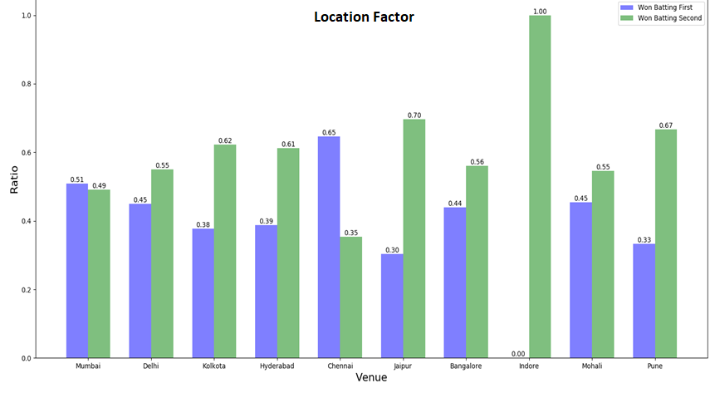
Visualization

Slide 5
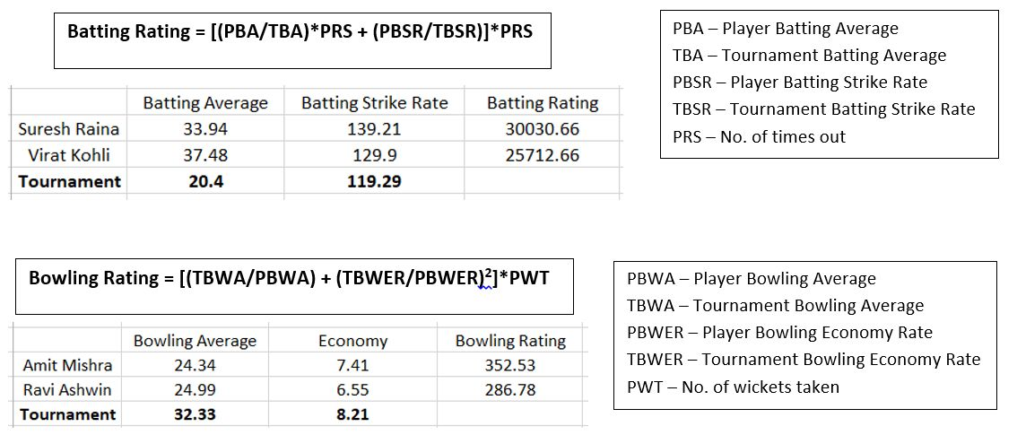
Player Profile

Slide 6
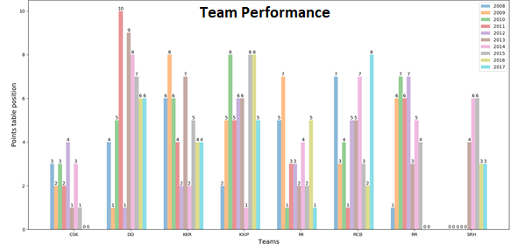

Slide 7
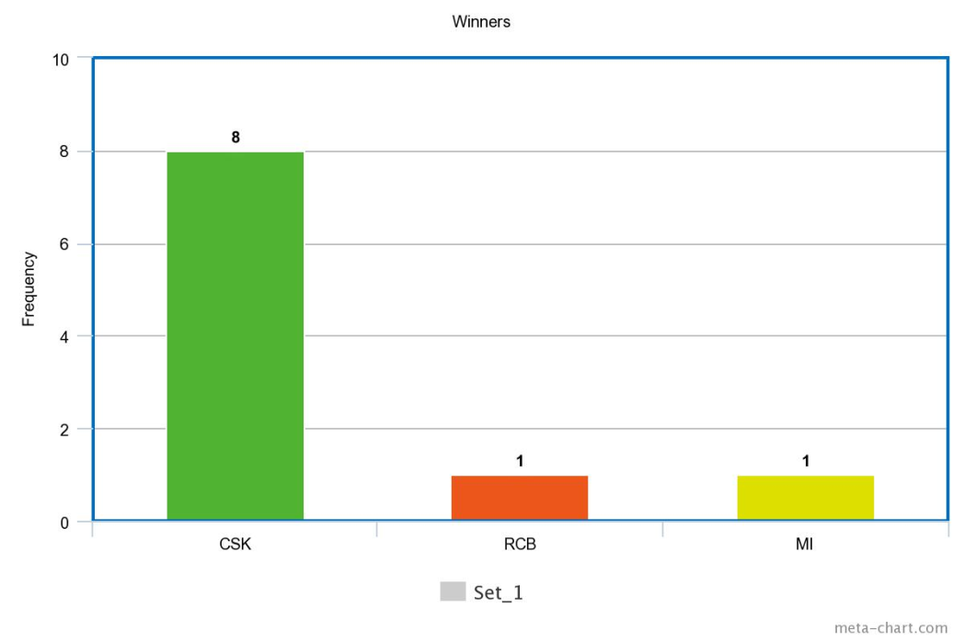
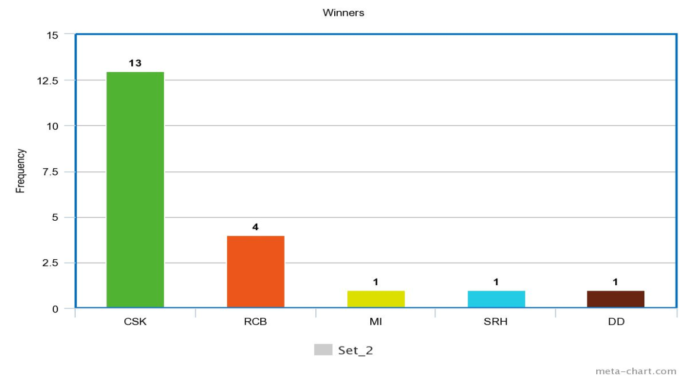
Simulation Trend

Slide 8
Points Table
Team | Wins | Loss | Tie | Points | Net_Run_Rate
Chennai Super Kings | 6 | 1 | 0 | 12 | 0.471429
Mumbai Indians | 4 | 3 | 0 | 8 | 0.285714
Rajasthan Royals | 4 | 3 | 0 | 8 | 0.107143
Kings XI Punjab | 4 | 3 | 0 | 8 | -0.08571
Royal Challengers Bangalore | 4 | 2 | 0 | 8 | -0.13333
Delhi Daredevils | 3 | 4 | 0 | 6 | 0.207143
Kolkata Knight Riders | 2 | 5 | 0 | 4 | -0.5
Sunrisers Hyderabad | 1 | 7 | 0 | 2 | -0.325
Team | Wins | Loss | Tie | Points | Net_Run_Rate
Chennai Super Kings | 12 | 2 | 0 | 24 | 0.328571
Kings XI Punjab | 8 | 6 | 0 | 16 | 0.007143
Delhi Daredevils | 7 | 7 | 0 | 14 | 0.217857
Rajasthan Royals | 7 | 7 | 0 | 14 | 0.064286
Mumbai Indians | 7 | 7 | 0 | 14 | 0.028571
Royal Challengers Bangalore | 7 | 7 | 0 | 14 | -0.05714
Sunrisers Hyderabad | 4 | 10 | 0 | 8 | -0.275
Kolkata Knight Riders | 4 | 10 | 0 | 8 | -0.31429
Mid-season points table
Final points table

Slide 9
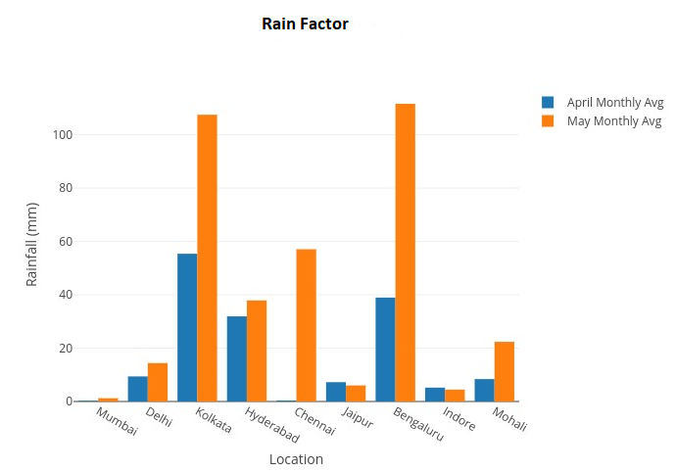
Rain Factor

Slide 10
Cap Winners
 | Player | Runs
1 | CH Gayle | 479
2 | G Gambhir | 468
3 | V Kohli | 434
4 | RG Sharma | 415
5 | DA Warner | 413
 | Player | Wickets
1 | RA Jadeja | 36
2 | DT Christian | 35
3 | MP Stoinis | 33
4 | Imran Tahir | 32
5 | DJ Bravo | 32
Orange Cap
Purple Cap

Slide 11
Relevance to CISCO

Slide 12
References
A new Machine Learning based Deep Performance Index for Ranking IPL T20 Cricketers – International Journal of Computer Applications
https://en.wikipedia.org
https://www.kaggle.com/josephgpinto/ipl-data-analysis
http://www.cricbuzz.com/

Slide 13
THANK YOU

